Slide 1
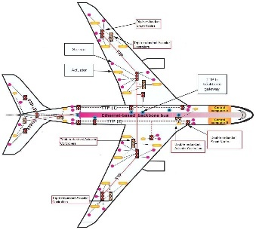

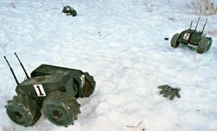

Networks of Embedded Systems (NES)
Intelligent
Highways
Collaborative
Robots
Wildlife
Monitoring
Automotive
Networks
Large scale, ad hoc networks
Heterogeneous node functionality: sensors, intelligent cameras, smart appliances
Limited resources: CPU, memory, bandwidth, energy
Wired/ Wireless Communication
Volatile, possibly mobile

Slide 2
Networked Embedded Systems
Deeply Embedded Systems
Sensor networks
Distributed control applications
Industrial Automation – Industry 4.0
Automotive Electronics + ITS
Ubiquitous computing environments
IoT

Slide 3
NES - Characteristics
Involve many energy-constrained, resource-limited devices operating in concert
Largely self-organizing and self-maintaining
Must be robust despite significant noise, loss, and failure
Real-Time Applns

